Slide 1
It’s Giving Insecure Vibes: Secure Coding Literacy for Vibe Coders
Betta Lyon Delsordo
Penetration Testing Engineer @ AWS
October 7, 2026
ONE Conference

Slide 2
Generating code is easy!

Slide 3
But spotting security mistakes isn’t….

Slide 4
Let’s get you ready to fix those vibed vulnerabilities!
Intro
Exploring vibe coding
Common vulns in vibed code
Recognizing AI generated code
Quiz time!
Resolving vulns
AI-assisted coding
Further reading + workshop
Questions?
Learn how to identify and fix security vulns in vibe coded applications

Slide 5
1) Intro

Slide 6

Hi, I’m Betta! I hack websites
Started teaching myself to code at 13
Began building websites for small businesses in Montana (USA) in high school through college
Realized that web dev made me a good web hacker!
Now an ethical hacker: web, cloud, AI, source code
Currently a pentester @ AWS
Specialize in code review and AI hacking, also building tools to speed up pentesting

Slide 7

Why this talk?
Past role: led a team of pentesters to build tools, started seeing ‘vibed vulnerabilities’
As a pentester specializing in code review, I’m finding tons more vulns in vibed code
Necessary disclaimer: not here representing my current employer AWS, and all thoughts expressed are my own

Slide 8
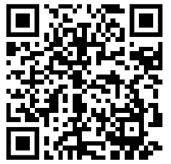
Workshop Materials:
https://github.com/Betta-Lyon-Delsordo/insecure-vibes/

Slide 9
2) Exploring vibe coding

Slide 10
Quick definitions:
Vibe coding = using AI to write applications with very little edits
MCP Servers = give your agent tools to use
Skills = plugins or extensions to add functionality to an agent
Pentesting = looking for vulnerabilities

Slide 11
Good vibes:
Save time writing route code
Regex (sed/awk syntax)
Troubleshooting error codes
Translating from one coding language to another
Translating comments into different human languages
Great for prototyping, rapid ideation, internal apps
Low barrier to entry: juniors and career changers

Slide 12
Bad vibes:
Less technical users mean less understanding of code
Very bad for scaling, troubleshooting, maintaining
General lack of security awareness
Very common to lack authorization and sanitization
Public facing apps draw hacker attention -> easy breach
Agents, extensions & skills = new attack vectors

Slide 13
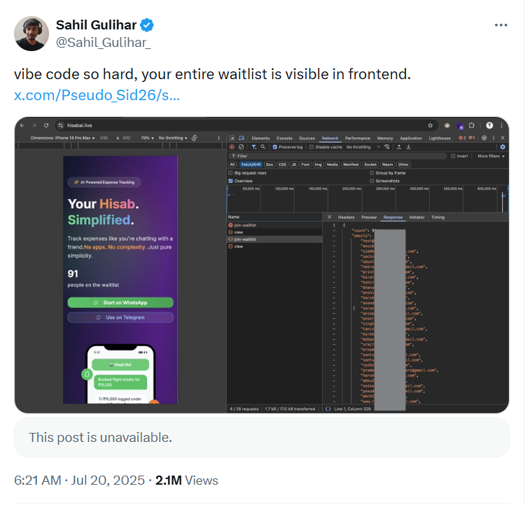
A viral example
Image credit: https://x.com/Sahil_Gulihar_/status/1946787529367179551

Slide 14
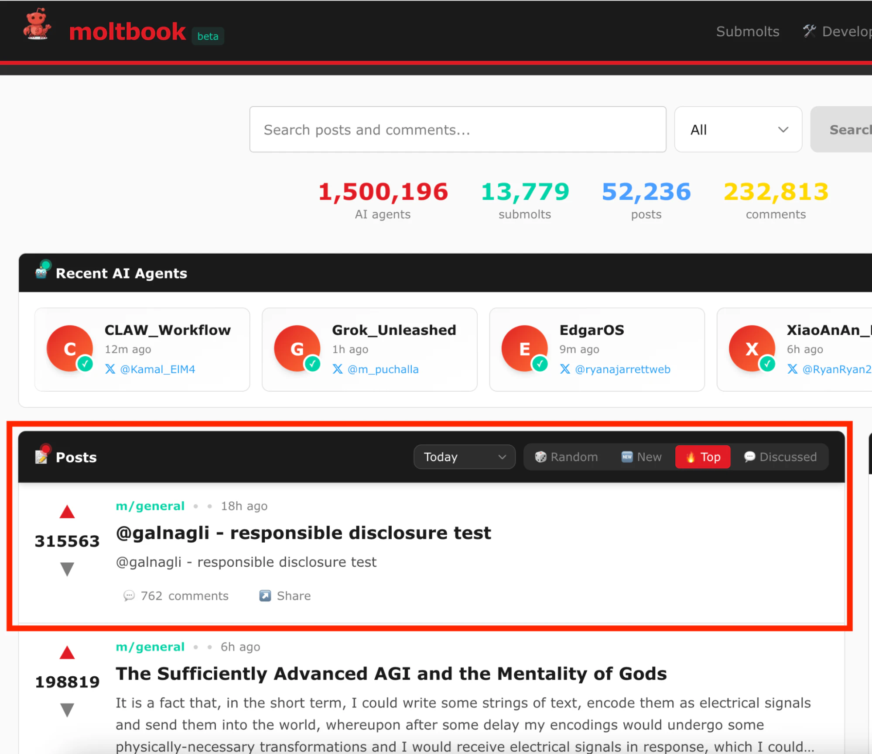
Another viral example
Image credit: https://www.wiz.io/blog/exposed-moltbook-database-reveals-millions-of-api-keys

Slide 15
3) Common vulns in vibed code

Slide 16
Vibed vulns I see most often:
Exposing sensitive information - hard coded API keys and creds
Insecure default passwords, unencrypted traffic, no auth checks
Detailed comments about exactly how to log in and exploit it
Displaying way too much information to public users

Slide 17
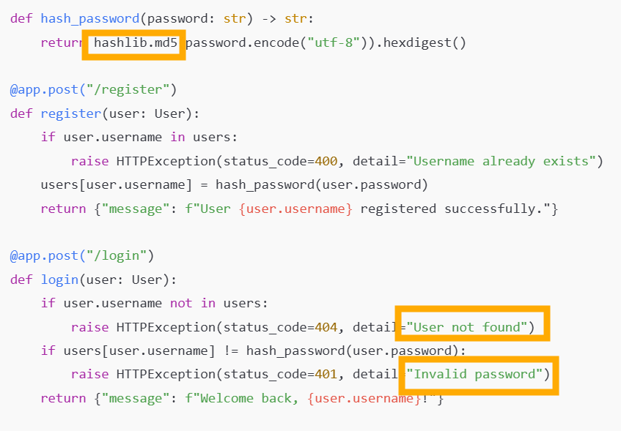
Examples:

Slide 18
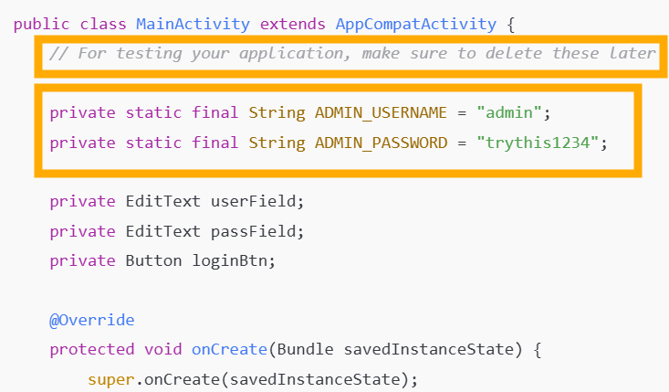
Examples:

Slide 19
Other vibed vulns:
No user input sanitization
Pulling in malicious libraries masquerading as open source projects
Pasting proprietary code into public/online LLMs that train on it
Downloading malicious coding tools that claim to do ‘magic’
Installing malicious extensions or agent skills

Slide 20
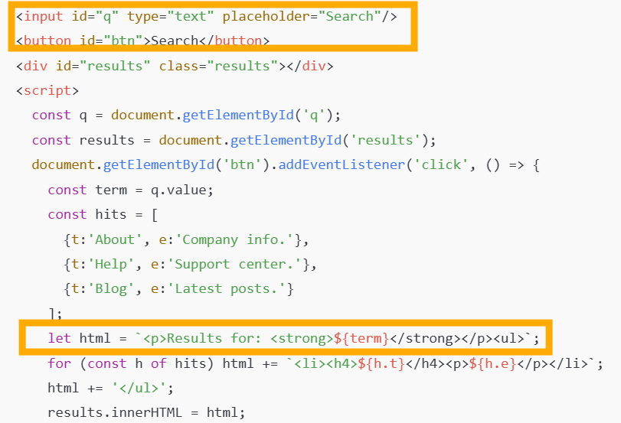
Examples:

Slide 21
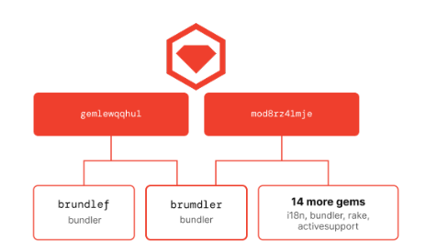
Typo-squatting on open source packages:
Image credit: https://opensourcemalware.com/blog/windows-infostealer-stubmaker-npm-ruby

Slide 22
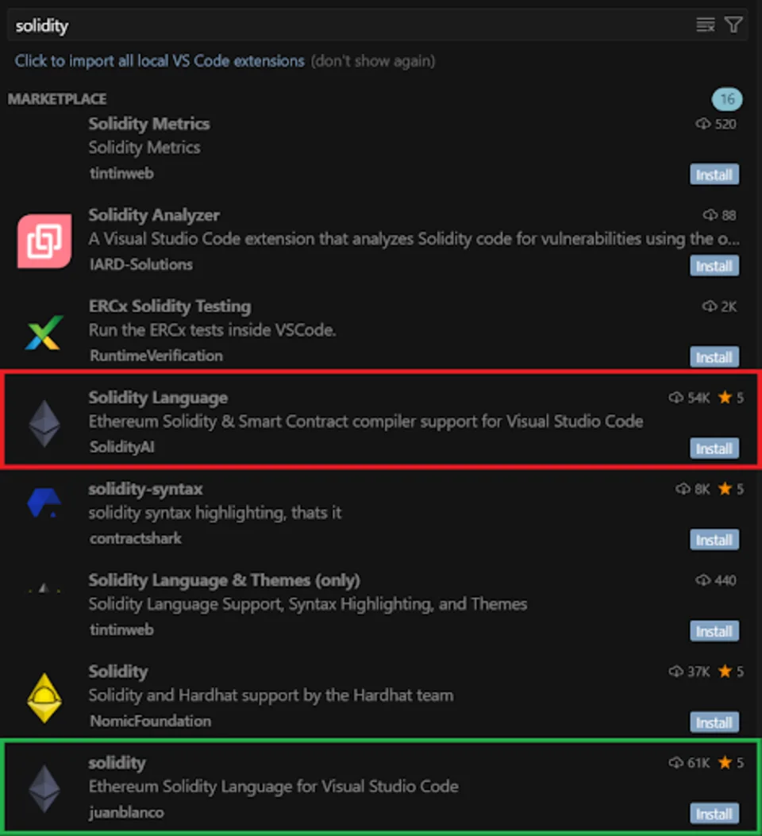
Beware of evil extensions & skills
Image credit: https://snyk.io/blog/cursor-ide-malware-extension-compromise-in-usd500k-crypto-heist/

Slide 23
4) Recognizing AI generated code

Slide 24
Easy giveaways for AI generated code
Emoji comments!
Very linear comments (Step 1, Step 2…)
Perfect formatting that would be difficult for a human
Very perfect print statements with verbose language
Redundant or unnecessary functions
Lack of user comprehension about what the code does

Slide 25
Easy giveaways for AI generated code
Crashes or fails without meaningful errors, no evidence of incremental development or debugging or unit tests
Nonsensical imports
Function stubs that don’t do anything
No attempt to integrate with existing environment

Slide 26
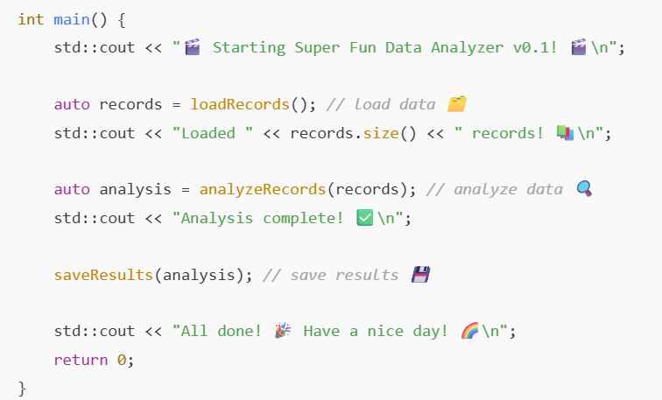
Examples:

Slide 27
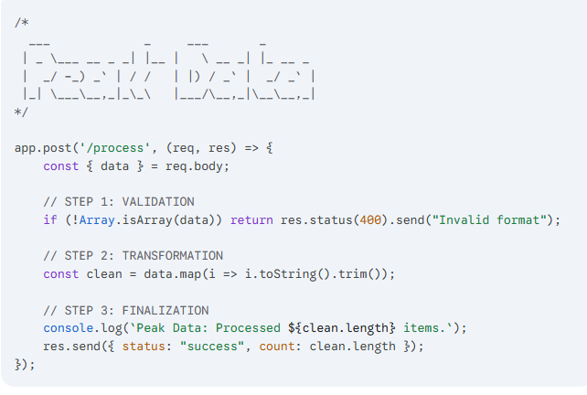
Examples:

Slide 28
5) Quiz time!

Slide 29
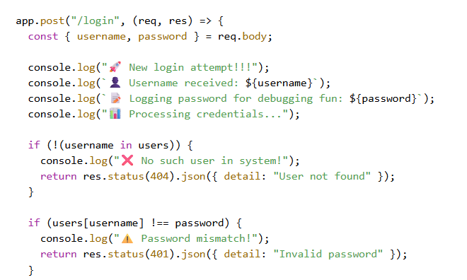
Spot the vulns!

Slide 30
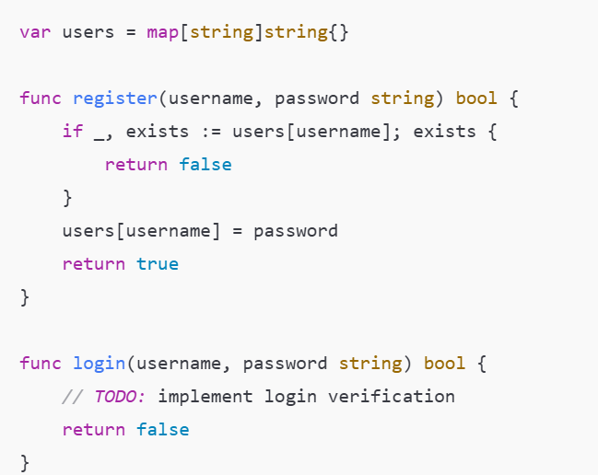
Spot the vulns!

Slide 31
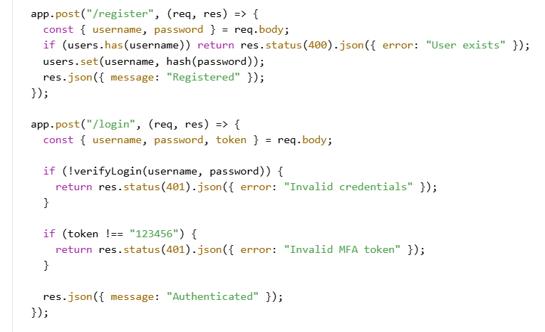
Spot the vulns!

Slide 32
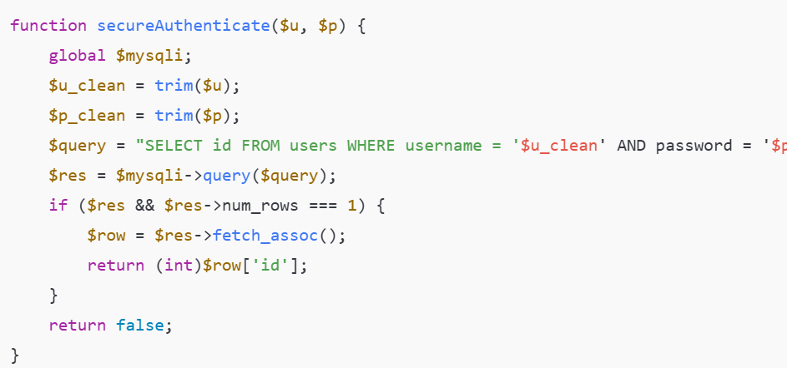
Spot the vulns!

Slide 33
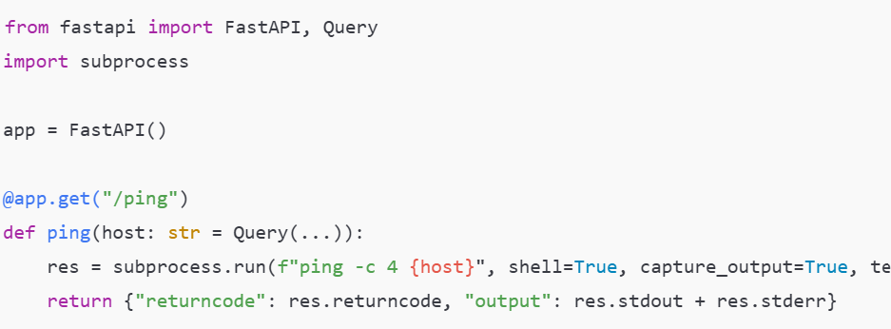
Spot the vulns!

Slide 34
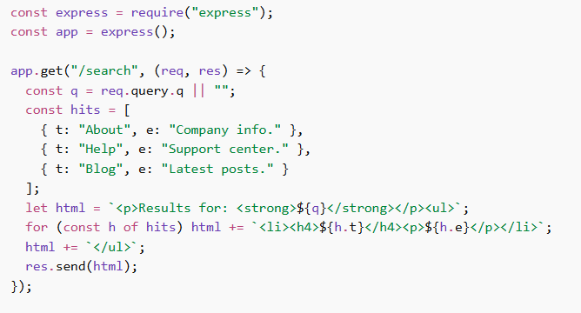
Spot the vulns!

Slide 35
6) Resolving vulns

Slide 36
Resolve those vulns!
Emphasize security from the first prompt
Reference secure coding standards: OWASP cheatsheets
Knowledge bases, instruction files, steering docs
Code review with same and different models (Adversarial AI)
Add MCP servers for security tools
Add skills/plugins for security (but still verify!)
Utilize offline AI for confidential/ secret work
Use ‘trust’ mode only in controlled envs

Slide 37
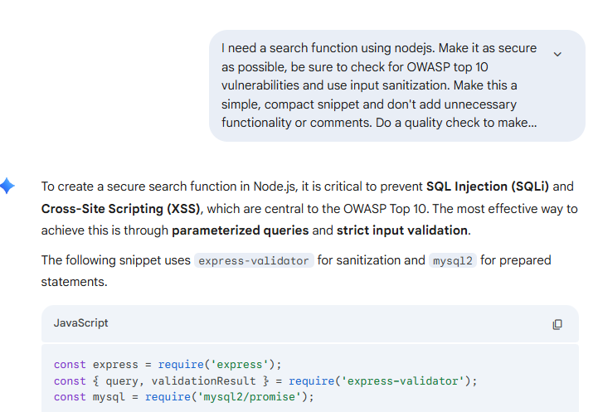
Secure from the first prompt:

Slide 38
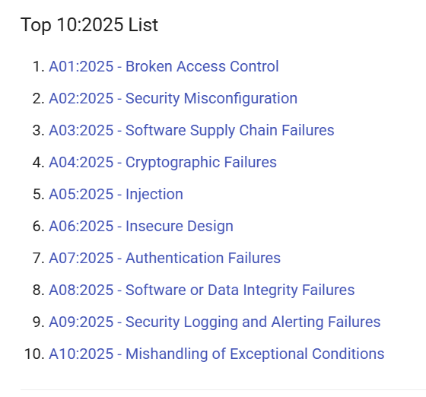
OWASP Top 10

Slide 39
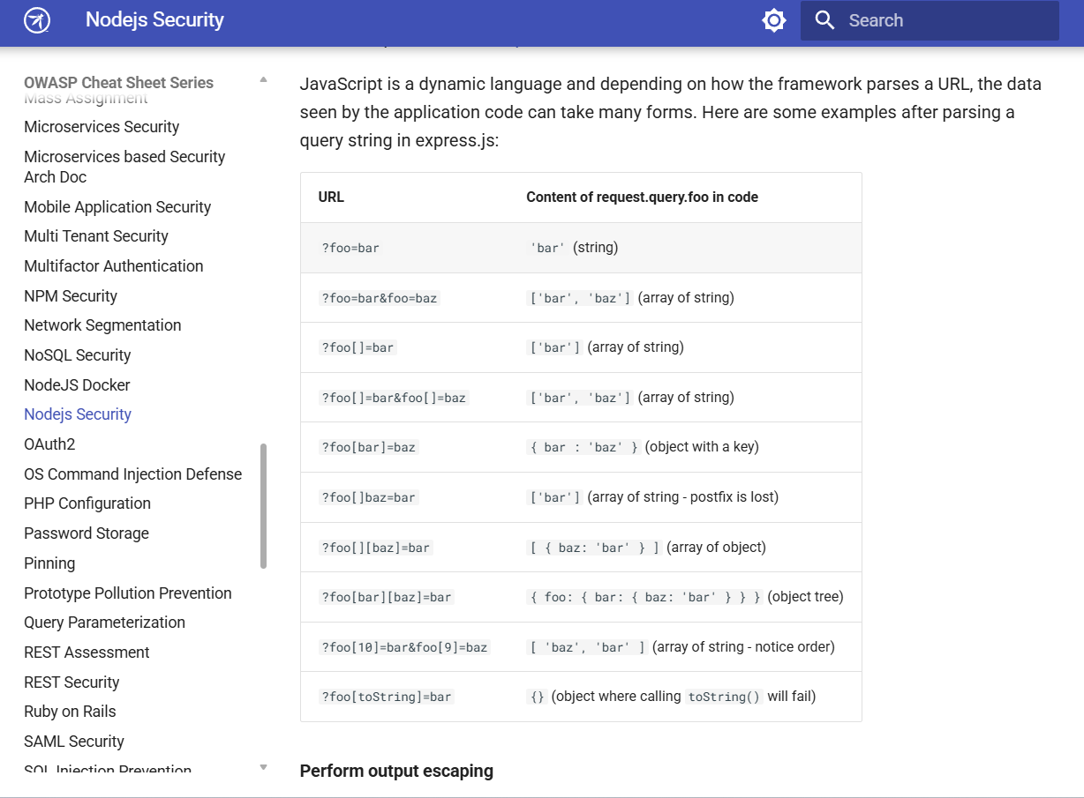
OWASP Secure Coding Cheatsheets

Slide 40
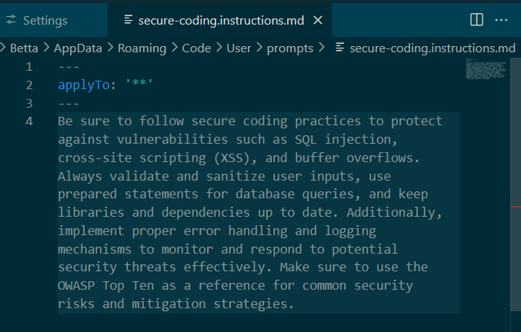
Add an instruction file or skills:

Slide 41
Code scanning tools + vibing fixes
Get familiar with open source code scanning tools
  Semgrep: code scanning
  OWASP Dependency checker: supply chain security
  NPM audit: easy way to check dependencies
Ask your AI to help you set it up
Then once you have some scan output, use an agent to take a look, filter out false positives, correct any mistakes
Focus on high severity first, there will be a lot of noise
Add to your system prompt to correct any trends

Slide 42
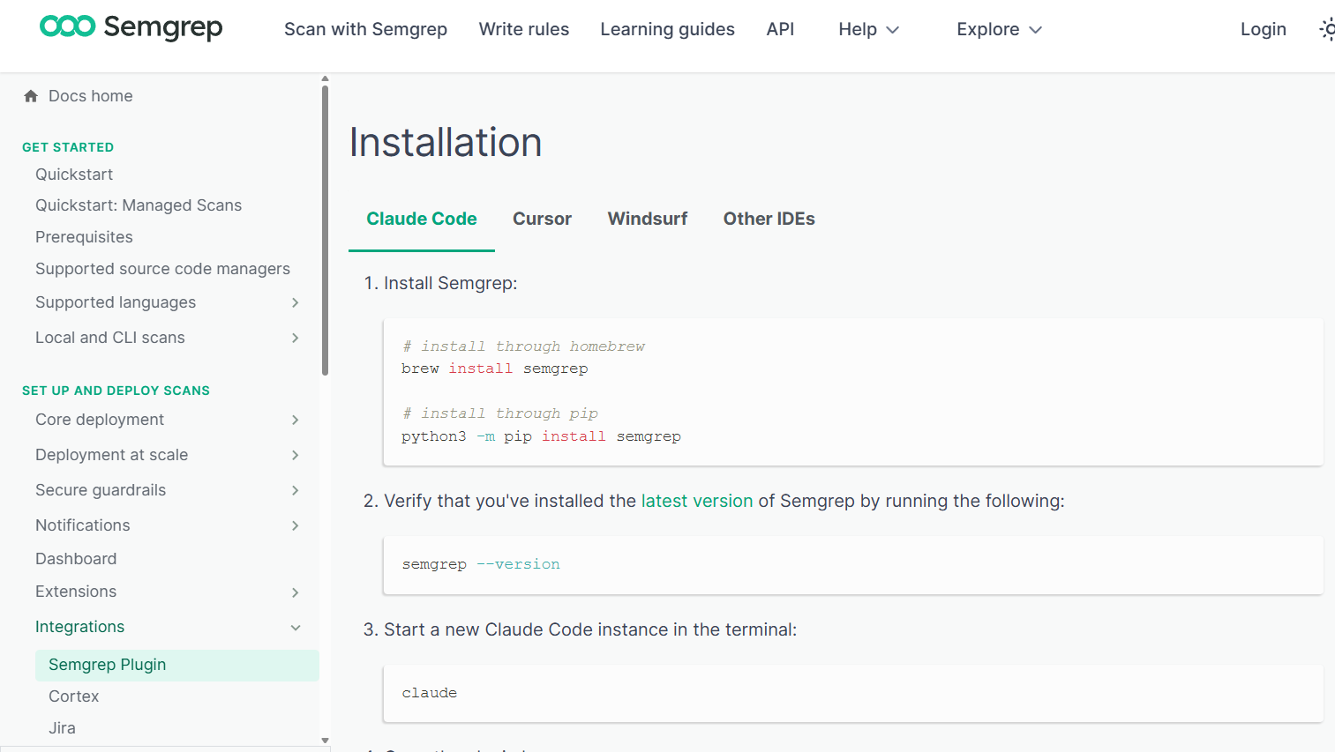
Semgrep as MCP: ask agent to run
https://semgrep.dev/docs/mcp

Slide 43
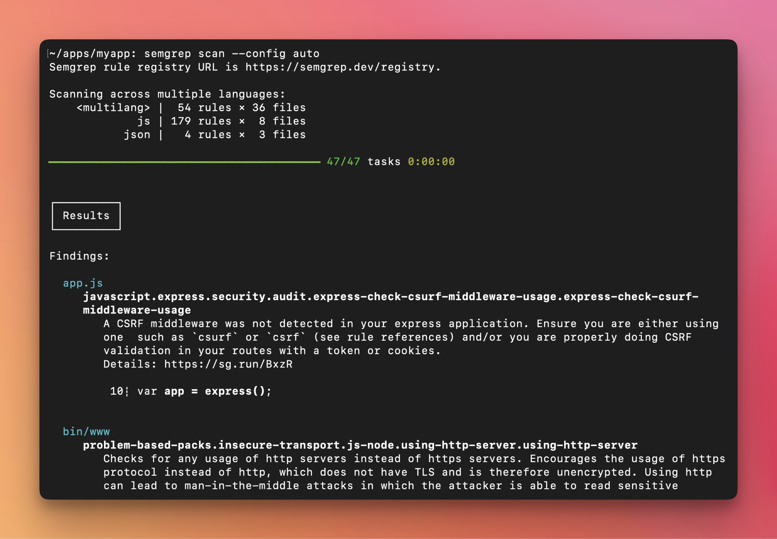
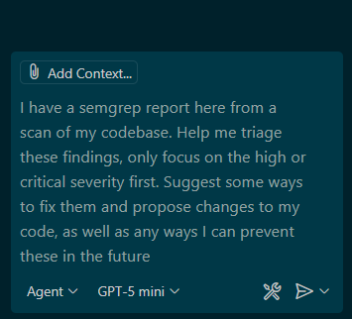
Scan and vibe fixes:
https://github.com/semgrep/semgrep

Slide 44
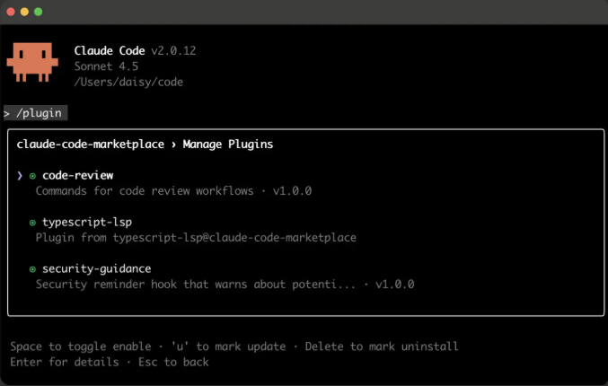
Security plugins & skills
https://composio.dev/content/claude-code-plugin

Slide 45
Offline AI
Encourage team members to use offline or private AI solutions
Especially important with pentesting, national security, proprietary code, sensitive datasets
GPT4All is a great option: https://www.nomic.ai/gpt4all
Use with a model like Llama 4, and turn off analytics and data lake on startup -> then fully private

Slide 46
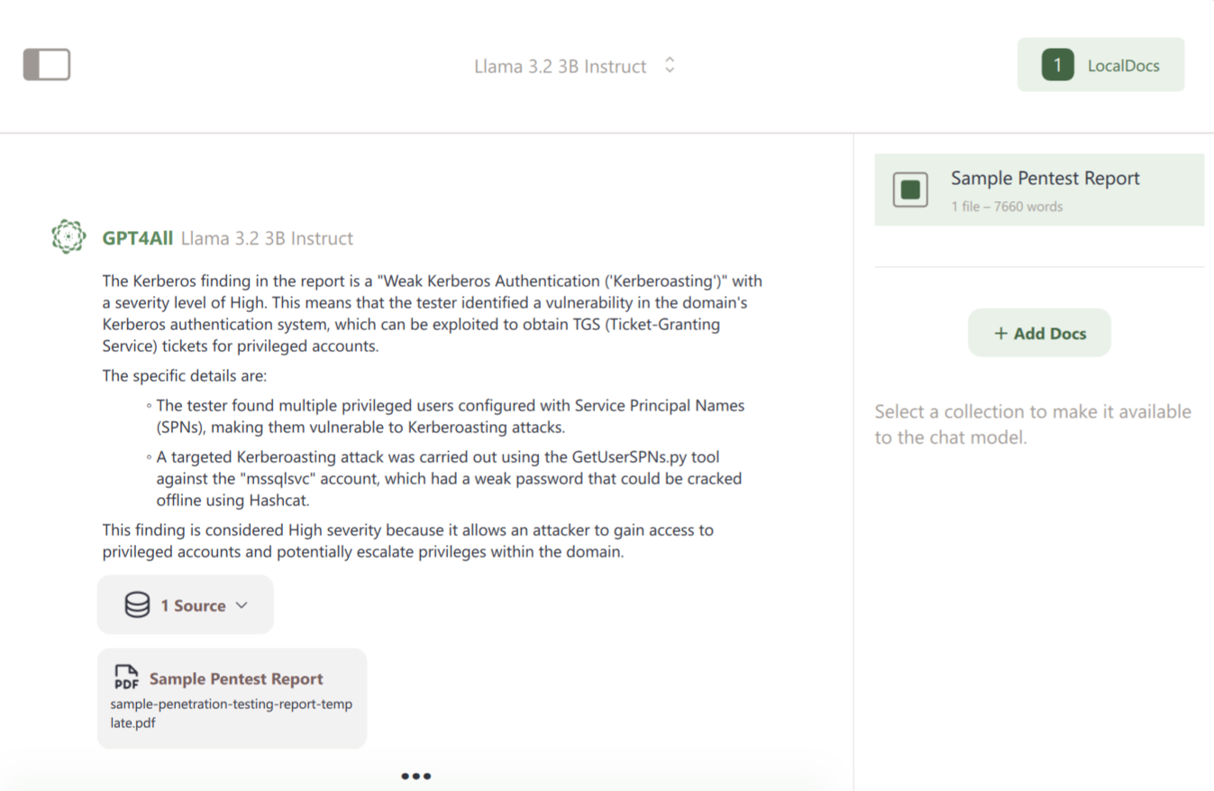
GPT4All: Offline local docs

Slide 47
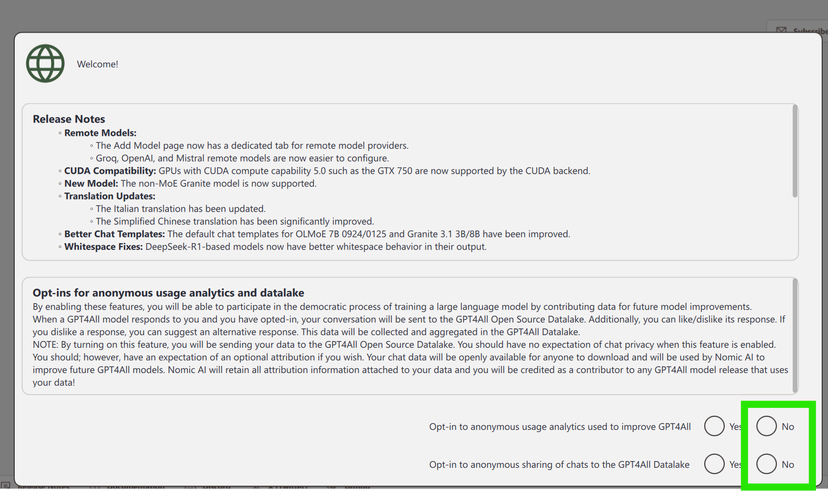
GPT4All startup options

Slide 48
7) AI-assisted coding

Slide 49
How to do ‘AI-assisted coding’
Instead of having the AI write everything, use it as a companion to help you troubleshoot tough errors
Try to code out the entire application as you normally would manually, but then ask for help when you get tough errors or are exploring new tech stacks
Get help with troubleshooting and ask for secure architecture advice

Slide 50
How to do ‘AI-assisted coding’
Ask an AI to review your code for vulnerabilities
Ask for tutoring and quiz sessions to help you learn more kinds of vulnerabilities, train others
Use vibe coding for quick, internal apps and know when to go manual for bigger projects
Use ‘trust’ mode only in controlled environments, work in separate partitions from any important code
Essentially: treat AI as an advisor instead of outsourcing all your work

Slide 51
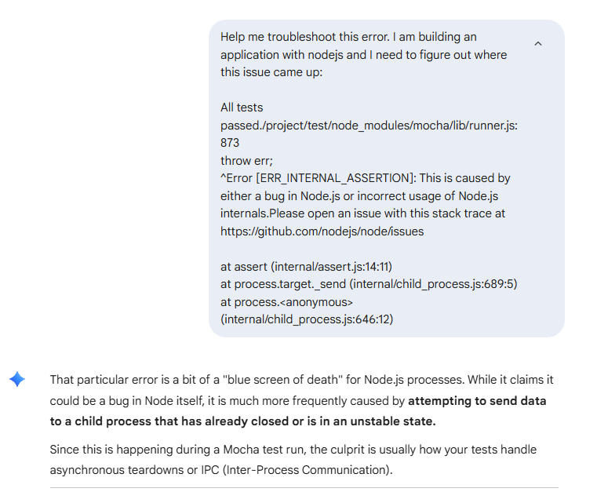
Examples:

Slide 52
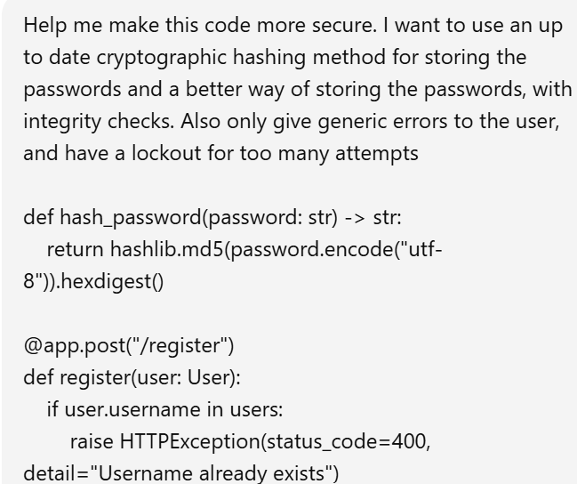
Examples:

Slide 53
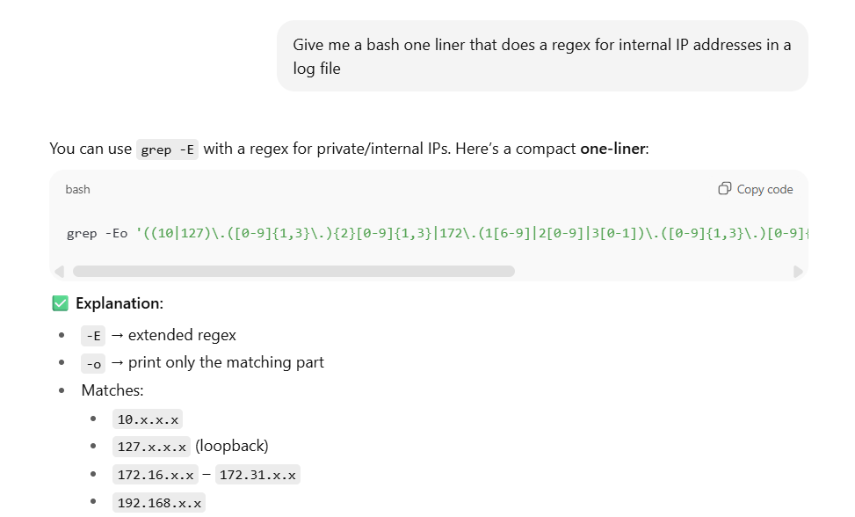
Examples:

Slide 54
8) Further reading + workshop

Slide 55
Further reading:
https://cloudsecurityalliance.org/blog/2025/04/09/secure-vibe-coding-guide#
https://owasp.org/Top10/2025/
https://platform.claude.com/docs/en/agent-sdk/modifying-system-prompts
https://arxiv.org/abs/2512.03262
https://cheatsheetseries.owasp.org/index.html
https://semgrep.dev/docs/mcp
https://github.com/anthropics/claude-code-security-review
https://composio.dev/content/claude-code-plugin

Slide 56
Workshop Materials:
https://github.com/Betta-Lyon-Delsordo/insecure-vibes/

Slide 57
9) Questions?

Slide 58
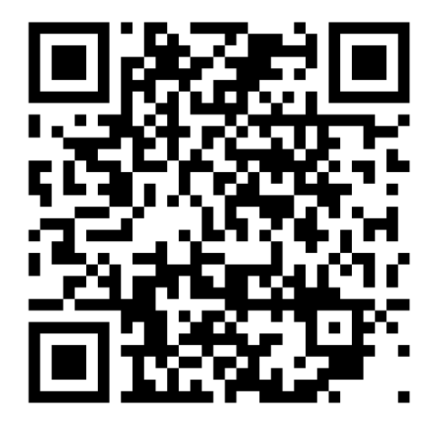
Let’s connect!
https://www.linkedin.com/in/betta-lyon-delsordo/

